Slide 1

Introduction to Data Analytics: Capstone Project
Predicting Fuel Economy Using EPA FE Trends Report
Group 3:
Noelle Baker Brian Link
Edward Katynski Rong (Tim) Situ
December 17, 2021

Slide 2
Outline
1. Project Question and Data Set | Noelle Baker
2. Initial Data Processing - Targeted Data Set - Initial Heat Map - Initial Factor Reduction - Factor Manipulation | Noelle Baker Rong (Tim) Situ
3. Exploratory Data Analysis - Data Head and Data Types - Check Data Characteristics - Reduced Factor Heat Map - Check Factor Distribution and Outliers - Check FE Relationship with Factors | Edward Katynski
4. Data Analysis - Linear Regression – With All Factors, Forwards, and Backwards - Check Effect of Each Factor on FE | Rong (Tim) Situ
5. Check Model Fit - Model Evaluation and Validation – Q-Q and Residual Plots | Brian Link
6. Final Results, Conclusions, and Lessons Learned | Brian Link
Confidential Business Information

Slide 3
Project Question and Data Set
Can you accurately predict future vehicle fuel economy using past vehicle fuel economy and other vehicle characteristics?
Using a data set gathered by the EPA, we will be exploring fuel economy trends of all light-duty passenger vehicles certified by the EPA.
We will be using these trends to develop a model to predict the fuel economy based on given characteristics.
Database location: https://www.epa.gov/automotive-trends/explore-automotive-trends-data#DetailedData
Database contains:
Data and characteristics of all vehicles produced and certified since 1975
Size: 1782 KB
5170 Data points, 50+ variables
Data aggregation:
Data set aggregated up to the Manufacturer – Model Year – Regulatory Class (Car or Truck) level
Data for individual Models not available in this data set
Factors primarily take one of two forms:
A fleet average: e.g., Vehicle Weight or Horsepower
A percentage of total fleet with that characteristic: e.g., Drivetrain – Front or Powertrain – Gasoline
Confidential Business Information

Slide 4
Initial Data Processing
Confidential Business Information

Slide 5
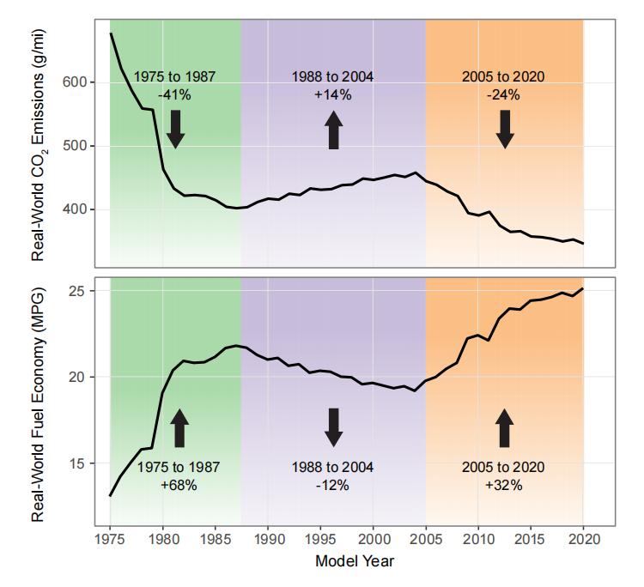
Targeted Data Set
Fuel economy has changed in three distinct groups since 1975.
1975 – 1987: fuel shortage in the U.S. led to demand for more fuel efficient vehicles
1988 – 2004: fuel economy improvements were stagnant, with no pressure from customers or regulatory agencies
2005 – 2020: fuel economy improvements forced by new regulations
2021 Preliminary Data: we’re excluding this data which is preliminary and incomplete.
Final Data Set = 2005 – 2020 MY
Using data from only the most recent timeframe will provide the most accurate model for future fuel economy performance.
Trends in Fuel Economy and CO₂ emissions since 1975 MY
Confidential Business Information

Slide 6
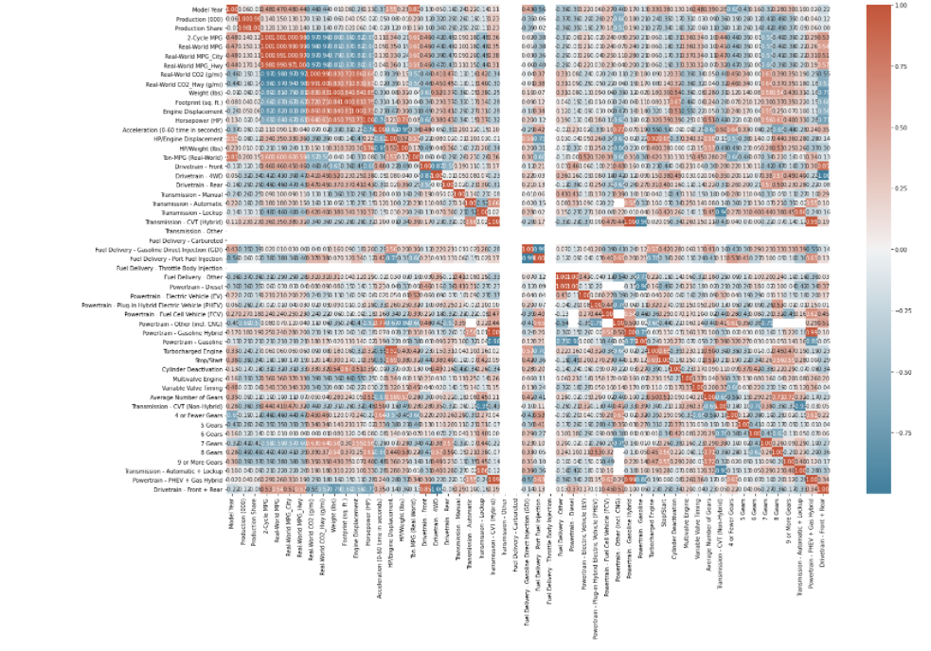
Initial Heat Map
Difficult to discern interactions with this many factors.
Factor reduction based on engineering judgement and knowledge of system would be beneficial.
Confidential Business Information

Slide 7
Initial Factor Reduction
Dependent Variable: Fuel Economy
Excluded variables: Vehicle Type, Production, Production Share, Real World MPG (Composite, City, Hwy), Real World CO2 (Composite, City, Hwy), HP/Engine Displacement, HP/Weight, Ton-MPG, Transmission-Other, Transmission – Manual, Fuel Delivery (Carbureted, Throttle Body Injection), Powertrain (FCEV, CNG, Other), Differentiate Gears (≤4, 5, 6, 7, 8, ≥9)
Categorical Variables | Numeric Variables
Fuel Economy
Manufacturer Region
U.S.
Europe
Model Year
Regulatory Class
Asia
Weight
Drive
Transmission
Front + Rear
4WD
Auto + Lockup
Powertrain
Gas
EV
FHEV+PHEV
Car
Truck
Fuel Delivery
GDI
PFI
CVT (Hybrid)
CVT (non-hybrid)
Other (EVs)
Fuel Economy
Stop/Start
Cylinder Deactivation
Multivalve Engine
Variable Valve Timing
Average # of Gears
Horsepower
Engine Displacement
Footprint
Confidential Business Information

Slide 8
Factor Manipulation
Initial factor manipulation needed to prepare data set for analysis
Drop Unwanted Columns
Replace Erroneous Entries
Convert Columns from Object to Numeric
Drop data < 2005 MY and Preliminary 2021 MY
Condense Manufacturers
Combine Trans., Powertrain, Drive Columns
Simplify Column Names
Create List of Dummy Columns & Variables
Confidential Business Information

Slide 9
Exploratory Data Analysis
Confidential Business Information

Slide 10
Data Head
Print data head with remaining columns
Observations:
Data has been reduced to 24 columns
Manufacturer was categorized and then transformed into two dummy variables: Domestic and European. Asian is not listed (Asian indicated by Domestic = 0 and European = 0)
Similarly for Reg Class – a single dummy variable was created to represent both Car and Truck. A Car is indicated by Truck = 0
 | MY | MPG | Weight | Footprint | EngDisp | HP | AWD | CVT_Hybrid | PortFuelInj | FuelOther | ... | MultiVlv | VVT | Gears | CVT | AT | PT_PHEV | NotAWD | MFG_Domestic | MFG_European | RegClass_Truck
0 | 2013 | NaN | NaN | NaN | NaN | NaN | 0.00 | 0.00 | 0.00 | 0.00 | ... | 0.00 | 0.00 | NaN | 0.00 | 0.00 | 0.00 | 0.00 | 0.00 | 1.00 | 0.00
1 | 2014 | NaN | NaN | NaN | NaN | NaN | 0.00 | 0.00 | 0.00 | 0.00 | ... | 0.00 | 0.00 | NaN | 0.00 | 0.00 | 0.00 | 0.00 | 0.00 | 1.00 | 0.00
2 | 2015 | 35.27 | 4000.00 | 48.55 | 122.05 | 240.00 | 0.00 | 0.00 | 0.00 | 0.00 | ... | 1.00 | 1.00 | 8.00 | 0.00 | 0.00 | 0.00 | 0.00 | 0.00 | 1.00 | 0.00
3 | 2016 | 34.79 | 4000.00 | 48.56 | 122.05 | 240.00 | 0.00 | 0.00 | 0.00 | 0.00 | ... | 1.00 | 1.00 | 8.00 | 0.00 | 0.00 | 0.00 | 0.00 | 0.00 | 1.00 | 0.00
4 | 2017 | 31.25 | 4000.00 | 48.56 | 122.05 | 240.00 | 0.00 | 0.00 | 0.00 | 0.00 | ... | 1.00 | 1.00 | 8.00 | 0.00 | 0.00 | 0.00 | 0.00 | 0.00 | 1.00 | 0.00
Confidential Business Information

Slide 11
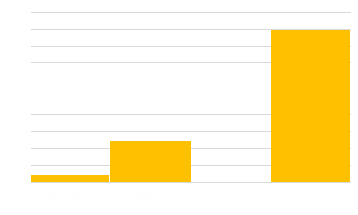
Check Data Types
<class 'pandas.core.frame.DataFrame'>
Int64Index: 1245 entries, 0 to 5140
Data columns (total 24 columns):
# | Column | Non-Null Count |  | Dtype
--- | ------ | -------------- |  | -----
0 | MY | 1245 | non-null | int64
1 | MPG | 1143 | non-null | float64
2 | Weight | 1143 | non-null | float64
3 | Footprint | 991 | non-null | float64
4 | EngDisp | 1143 | non-null | float64
5 | HP | 1143 | non-null | float64
6 | AWD | 1245 | non-null | float64
7 | CVT_Hybrid | 1245 | non-null | float64
8 | PortFuelInj | 1245 | non-null | float64
9 | FuelOther | 1245 | non-null | float64
10 | PT_EV | 1245 | non-null | float64
11 | PT_ICE | 1245 | non-null | float64
12 | ISG | 1245 | non-null | float64
13 | CylDeact | 1245 | non-null | float64
14 | MultiVlv | 1245 | non-null | float64
15 | VVT | 1245 | non-null | float64
16 | Gears | 1133 | non-null | float64
17 | CVT | 1245 | non-null | float64
18 | AT | 1245 | non-null | float64
19 | PT_PHEV | 1245 | non-null | float64
20 | NotAWD | 1245 | non-null | float64
21 | MFG_Domestic | 1245 | non-null | uint8
22 | MFG_European | 1245 | non-null | uint8
23 | RegClass_Truck | 1245 | non-null | uint8
dtypes: float64(20), int64(1), uint8(3)
Observations:
Data types appropriately defined as either numeric (float64) or categorical (uint8)
Non-null count is high
Non-null Count (Max = 1245)
Confidential Business Information

Slide 12
Check Data Characteristics
Observations:
Differences between the means and medians shows some skewness, which will be more apparent in the histograms.
Data values are in the expected range for these factors.
 | MY | MPG | Weight | Footprint | EngDisp | HP | AWD | CVT_Hybrid | PortFuelInj | FuelOther |  | MultiVlv | VVT | Gears | CVT | AT | PT_PHEV | NotAWD | MFG_Domestic | MFG_European | RegClass_Truck
count | 1245 | 1143 | 1143 | 991 | 1143 | 1143 | 1245 | 1245 | 1245 | 1245 | ... | 1245 | 1245 | 1133 | 1245 | 1245 | 1245 | 1245 | 1245 | 1245 | 1245
mean | 2013 | 29.47 | 4138.19 | 49.60 | 182.02 | 229.54 | 0.36 | 0.01 | 0.60 | 0.01 | ... | 0.84 | 0.79 | 5.72 | 0.11 | 0.13 | 0.01 | 0.29 | 0.25 | 0.22 | 0.54
std | 4.32 | 5.70 | 633.19 | 5.50 | 47.14 | 49.23 | 0.38 | 0.03 | 0.44 | 0.03 | ... | 0.33 | 0.36 | 1.41 | 0.26 | 0.32 | 0.03 | 0.40 | 0.43 | 0.41 | 0.50
min | 2006 | 15.41 | 2997.37 | 42.56 | 94.12 | 131.00 | 0.00 | 0.00 | 0.00 | 0.00 | ... | 0.00 | 0.00 | 1.00 | 0.00 | 0.00 | 0.00 | 0.00 | 0.00 | 0.00 | 0.00
25% | 2009 | 25.17 | 3626.34 | 45.84 | 144.25 | 187.24 | 0.00 | 0.00 | 0.03 | 0.00 | ... | 0.95 | 0.77 | 5.00 | 0.00 | 0.00 | 0.00 | 0.00 | 0.00 | 0.00 | 0.00
50% | 2013 | 28.71 | 4000.00 | 47.53 | 171.30 | 223.73 | 0.20 | 0.00 | 0.90 | 0.00 | ... | 1.00 | 1.00 | 6.00 | 0.00 | 0.00 | 0.00 | 0.00 | 0.00 | 0.00 | 1.00
75% | 2017 | 33.45 | 4578.64 | 51.66 | 213.26 | 266.79 | 0.71 | 0.00 | 1.00 | 0.00 | ... | 1.00 | 1.00 | 6.30 | 0.00 | 0.00 | 0.00 | 0.72 | 1.00 | 0.00 | 1.00
max | 2020 | 45.55 | 6668.90 | 68.43 | 366.14 | 379.28 | 1.00 | 0.27 | 1.00 | 0.21 | ... | 1.00 | 1.00 | 10.00 | 1.00 | 1.00 | 0.28 | 1.00 | 1.00 | 1.00 | 1.00
Confidential Business Information

Slide 13
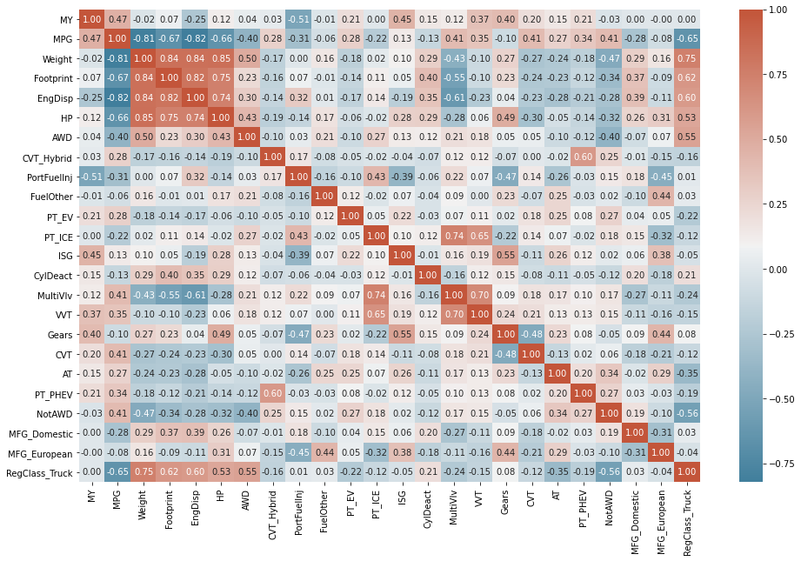
Heat Map
Observations:
Simplified heat map with reduced number of factors.
Identify factors which are poor predictors of FE
Values near 0 for ISG (stop-start), Fuel Other, CycleDeact, Gears, and MFG_European – expected to drop out of final regression
Strong predictors are likely to be present in a final regression
Values closer to 1 for Weight, Footprint, Engine Displacement
Confidential Business Information

Slide 14
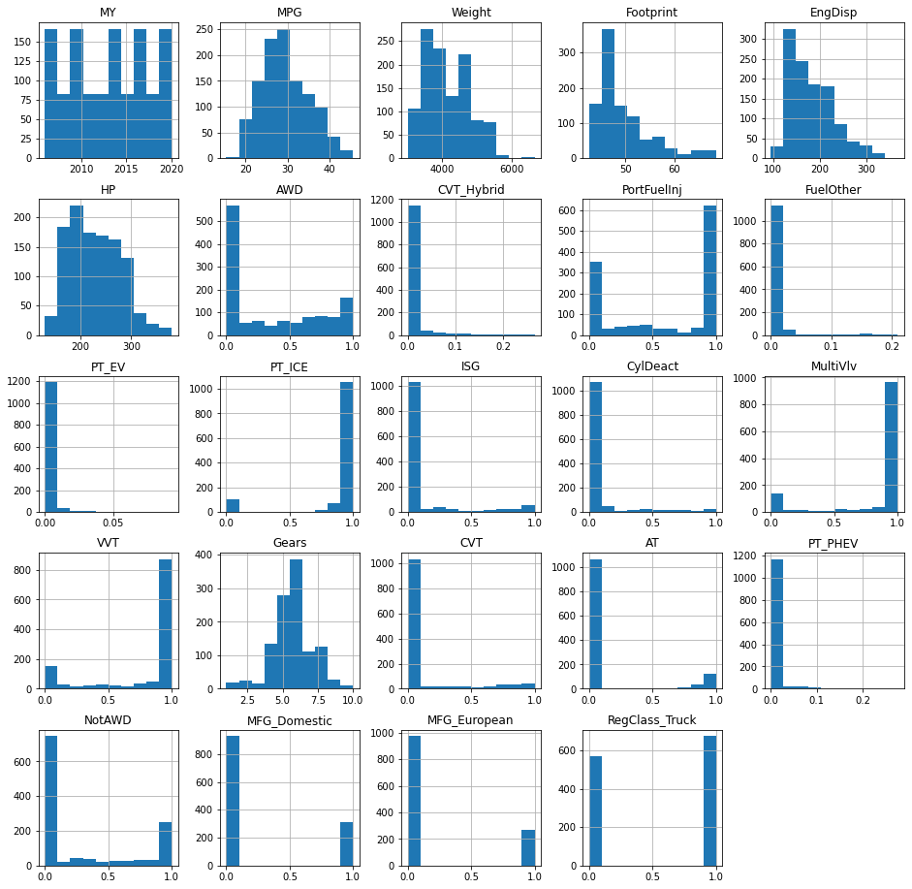
Check Factor Distribution and Outliers
Histograms of numerical factors
Observations:
Expected left-skewing can be seen in FE (MPG), Weight, Footprint, Engine Displacement, and HP.
Other factors with the scale 0 – 1 (or <1) show percentages of fleet.
Factors dominated by 1 show prevalent features like PT_ICE (vehicles with gasoline engines)
Factors dominated by 0 show rare factors like PT_PHEV (plug-in hybrid electric vehicles)
Confidential Business Information

Slide 15
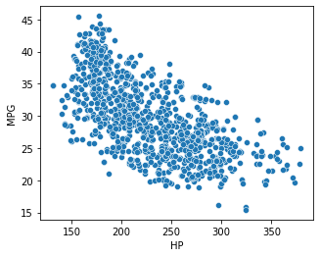
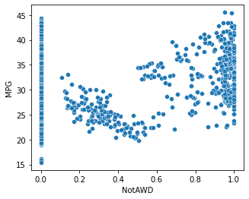
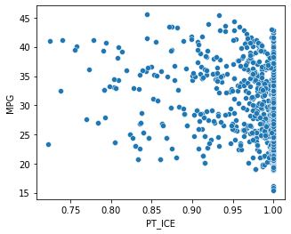
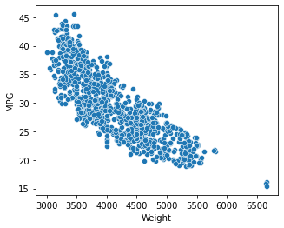
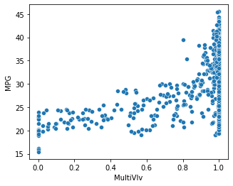
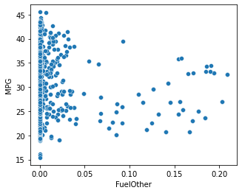
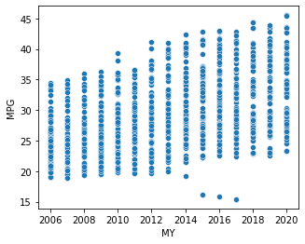
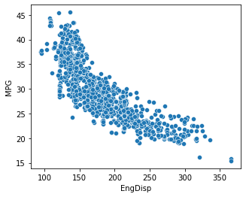
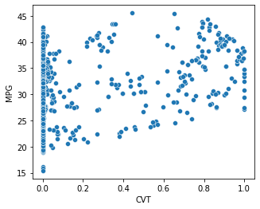
Check Fuel Economy Relationship with Factors
Scatter plots vs. Fuel Economy
Observations:
Examples of 24 remaining factors.
Trends can be observed in factors with stronger correlation, both positive and negative.
Some factors, with weak correlation, do not have a visible trend.
Model Year (below), shows discrete values and a positive correlation.
Negative Correlation
Positive Correlation
Weak Correlation
Confidential Business Information

Slide 16
Analysis
Confidential Business Information

Slide 17
Linear Regression with All Factors
First, divide data set into ‘test’ and ‘train’ sets in order to verify the final model.
Next, create a model with all 23 independent variables, and with Fuel Economy as the response variable
Effect of each factor on FE: (P)
17 factors show significance at 0.05
7 factors fail to show significance at 0.05 level:
AT, Fuel Other, HP, ISG, MFG_European, PT_EV, and PT_PHEV
Model Fit: (R-squared)
The model fit is very good at 92.4%
Next: determine if backwards and forwards regressions show similar results, eliminating the 6 factors not shown as significant here.
Confidential Business Information

Slide 18
Forward Linear Regression - Results
Use Forward Regression strategy on the training data set to add factors, one at a time, until reaching the significance level of 0.05
Effect of each factor on FE: (P)
17 factors are added until the loop reaches the factor PT_PHEV (with P > 0.05) and stops
These factors align with those that showed significance in the full regression model
Model Fit: (R-squared)
The model fit is also very good at 92.3%
Confidential Business Information

Slide 19
Backward Linear Regression - Results
Use Backward Regression strategy on the training data set to remove factors, one at a time, until reaching the significance level of 0.05
Effect of each factor on FE: (P)
Factors are removed until only 16 remain
This regression included one fewer factor than the forward regression, excluding HP.
Model Fit: (R-squared)
This model fit is excellent as well, at 92.3%
Confidential Business Information

Slide 20
Check Model Fit
Confidential Business Information

Slide 21
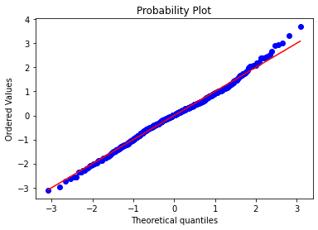
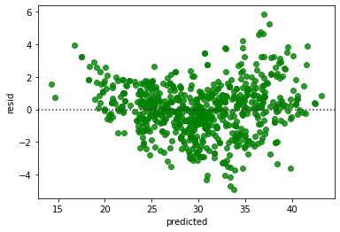
Model Evaluation and Validation
Both Forward and Backward models have similar fits.
Backwards model is simpler, with 1 fewer factor, so we choose this one for further validation.
Find MAE, MSE, RMSE and MAPE
MAE is 1.21 | MSE is 2.48 | RMSE is 1.57 | MAPE is 306.92
Check model assumptions using Q-Q Plot and Residuals Plot
Q-Q
Compares the actual FE values with the predicted values to determine the probability that they have the same distribution.
This plot confirms the two data sets are very well matched, following the 1:1 line, with some deviation at the extremes.
Residual Plot
Checks to see:
if the residuals show a random distribution, indicating a linear regression is appropriate for this data set.
or if there is a pattern in the residuals, indicating a different type of fit may be more appropriate.
This residual plot shows a random distribution --> linear regression is appropriate.
Confidential Business Information

Slide 22
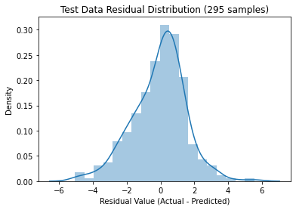
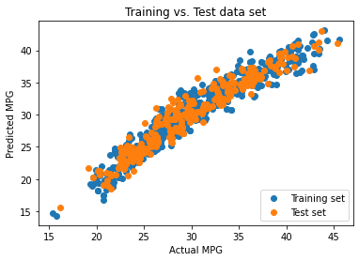
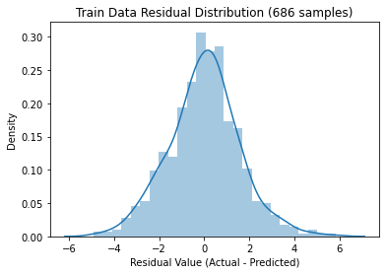
Model Evaluation and Validation
Check for model overfitting
Run test data set through hard-coded backwards elimination model
Training vs. Test Set Data Results
Histograms of the ‘test’ and ‘train’ sets (to the right) show similar near-normal distributions
A scatter plot, below, of the paired data (Actual and Predicted FE) are well matched for the ‘test’ and ‘train’ datasets
Confidential Business Information

Slide 23
Results / Conclusion
Confidential Business Information

Slide 24
Final Results, Conclusions, and Lessons Learned
Significant Predictors of Fuel Economy
Data set preparation is critical to producing a good model. Preparing a data set that contains missing values and superfluous columns can occupy a large portion of the project time.
Data at the vehicle model level (e.g. Sonata) would have provided a more accurate tool to predict fuel economy – aggregation at the fleet level loses specificity and dampens the results.
The full linear regression, backwards regression, and forwards regressions all produced well-fit models. The backwards regression contained the least factors and was therefore the best choice for predicting fuel economy.
The final model selected had 16 factors that were significant predictors of FE
The goodness of model fit was confirmed using the Q-Q plot and Residual plot.
Model Year
CVT
Weight
Not AWD
Footprint
Man_Domestitic
Engine Disp.
Reg Class - Truck
AWD
Gears
CVT-Hybrid
VVT
PFI
Multivalve
PT-ICE
Cyl Deact
Confidential Business Information

Slide 25

THANK YOU

Slide 26
Appendix A: Python Code Base
** Scroll in presentation mode or by editing TextBox object**
Confidential Business Information

